Slide 1
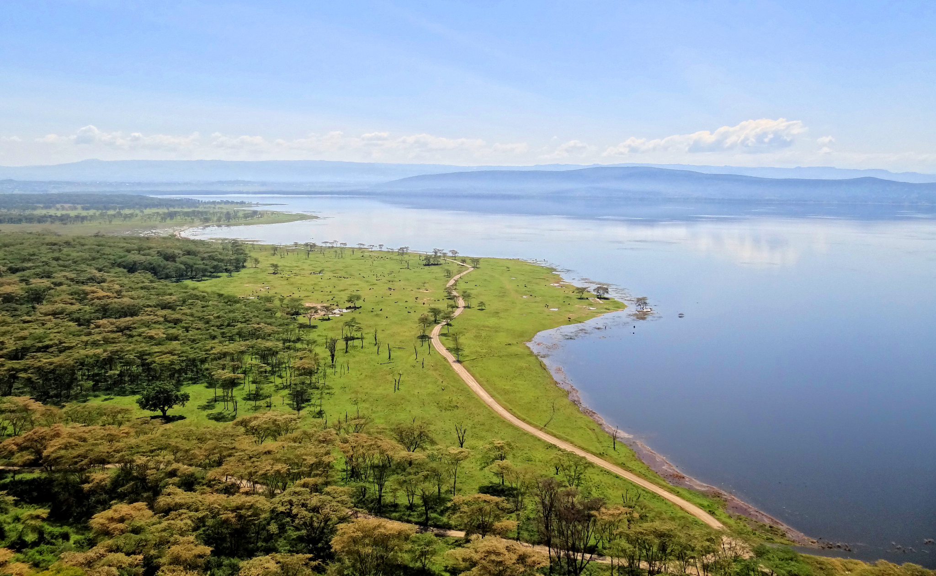
Food Webs and Network Ecology
Bjørn Christian Tørrissen ( 2012 )
Olari Eugenia, Goretti Francesca, Gonon Yoan, Katende Ukasha, Denis Drahokoupil
Notes:
https://docs.google.com/document/d/16MW5gAP8jj4dnCR-bt6L1cZ3rx_Kois6d9RDyF61f1I/edit?usp=sharing

Slide 2





The Team
Francesca Goretti
Denis Drahokoupil
Eugenia Olari
Yoan Gonon
Ukasha Katende
Notes:
https://docs.google.com/document/d/16MW5gAP8jj4dnCR-bt6L1cZ3rx_Kois6d9RDyF61f1I/edit?usp=sharing

Slide 3
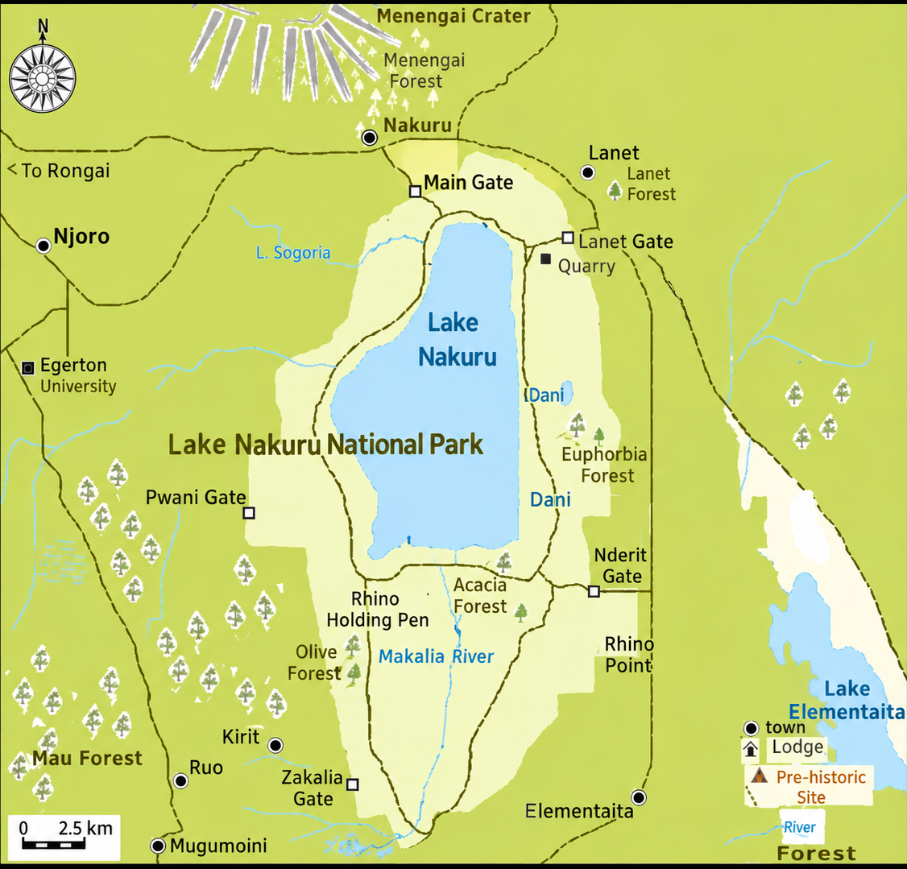
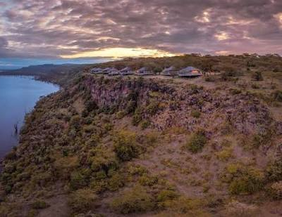
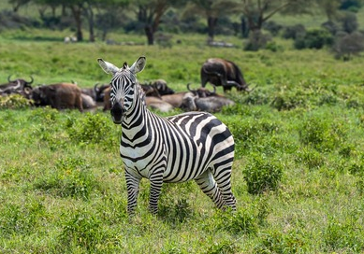
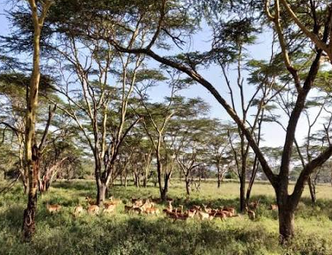
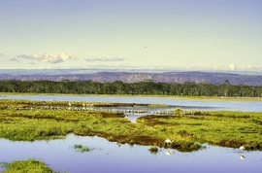
Shah, P (2016) Convention on biological diversity and rural-urban connections with reference to Kenya
Notes:
https://docs.google.com/document/d/16MW5gAP8jj4dnCR-bt6L1cZ3rx_Kois6d9RDyF61f1I/edit?usp=sharing

Slide 4

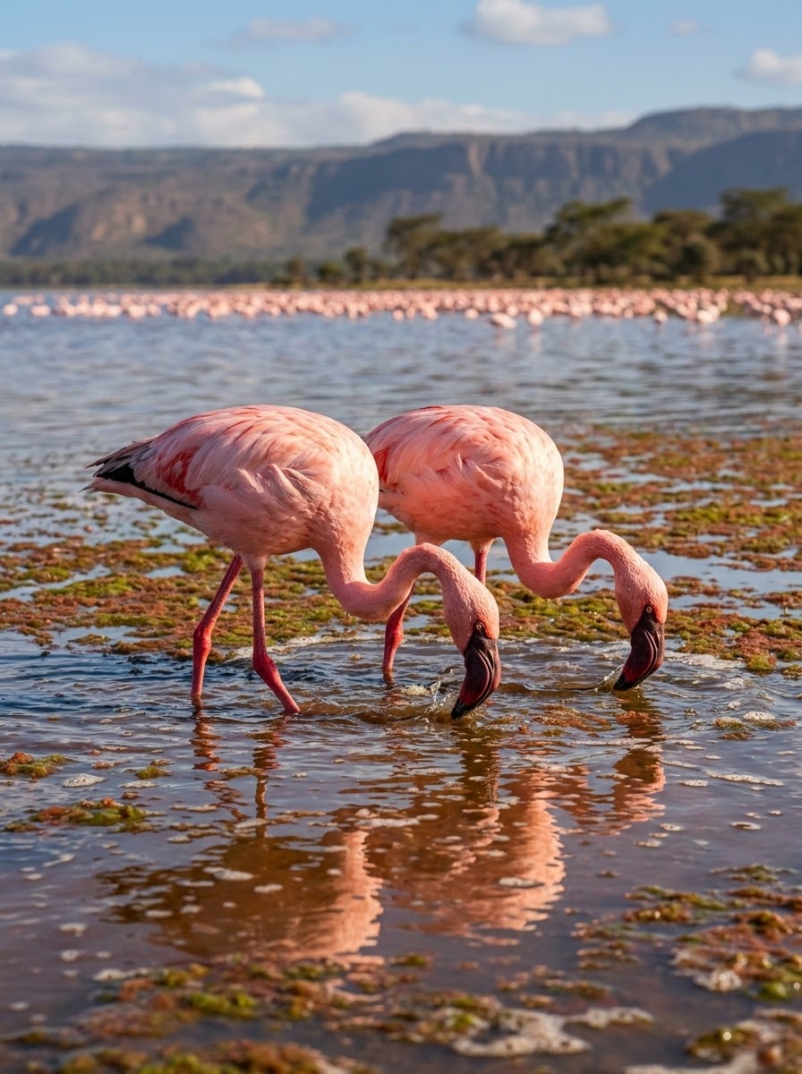
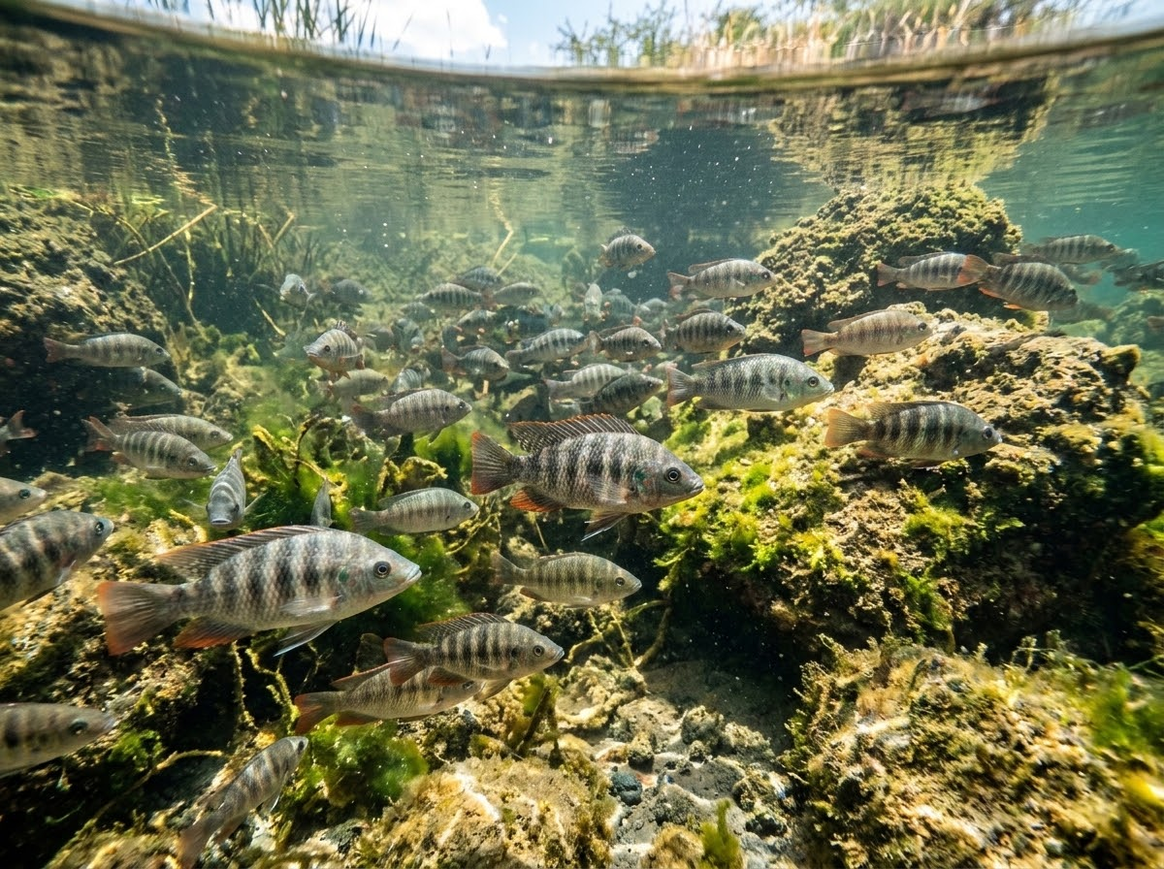
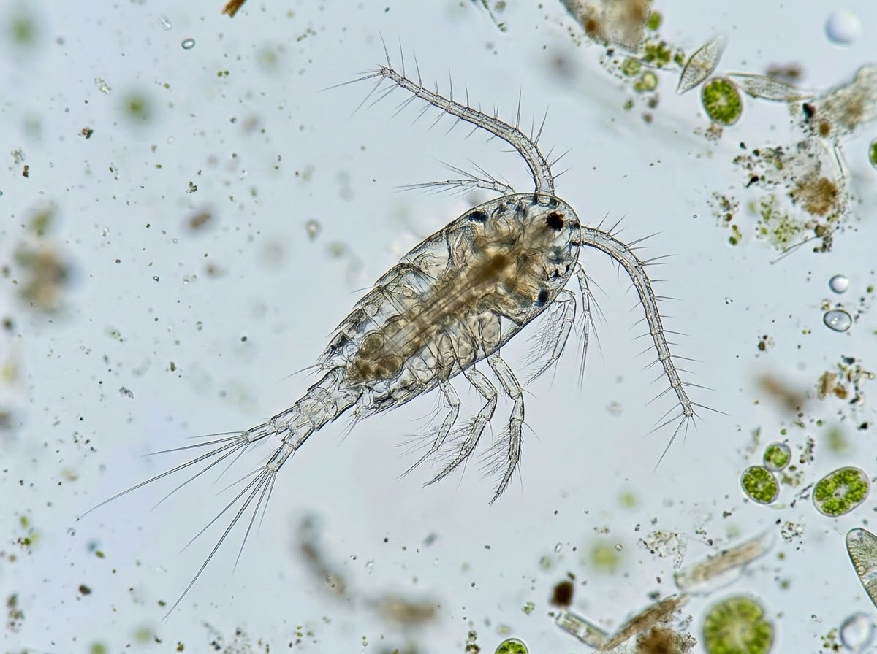
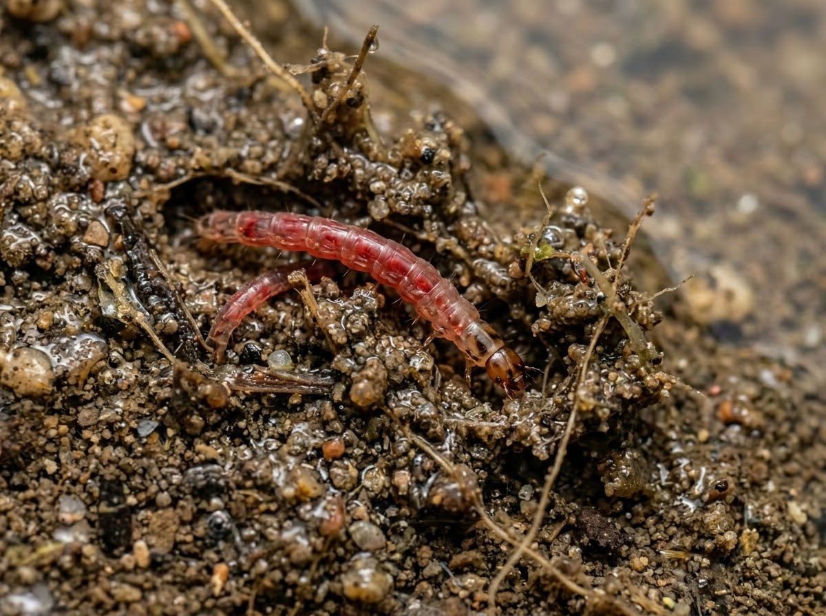
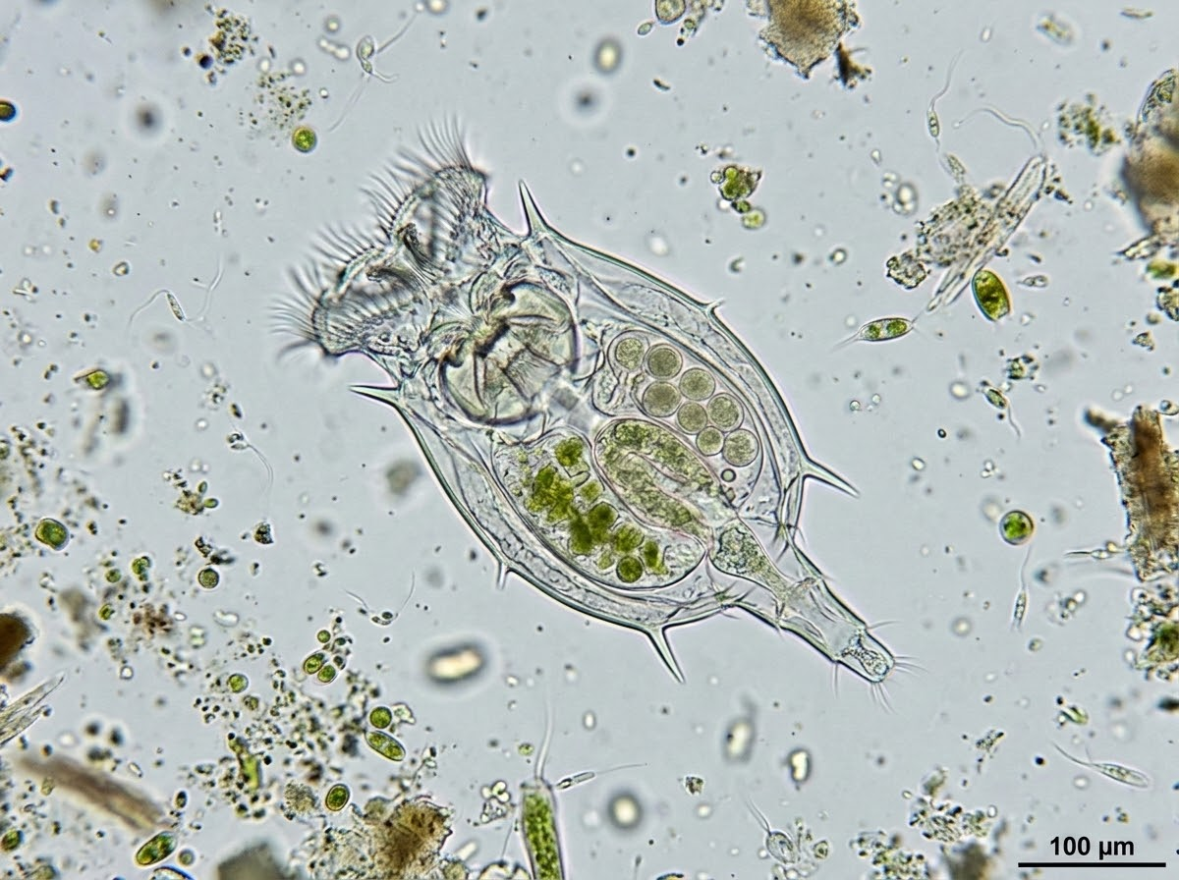
Vareschi, E. (1978). The ecology of Lake Nakuru
Primary Consumers in the Aquatic Food Web
Lesser Flamingo
Soda Tilapia
Copepod
Chironomid Larvae
Rotifer
Phoeniconaias minor
Most dominant consumer in biomass.
Specialized filter feeder consuming cyanobacteria (Spirulina/Arthrospira) in alkaline waters.
Alcolapia grahami
Key alkaline-adapted cichlid species.
Introduced fish feeding directly on algae, essential to lake energy transfer.
Lovenula africana
Major pelagic zooplankton.
Critical primary consumer driving planktonic biomass in the open water food web.
Leptochironomus deribae
Abundant benthic insect larvae.
Consumes organic sediment and algae, supporting benthic and aquatic food chains.
Brachionus dimidiatus
High consumption rate grazer.
Though small in individual biomass, possesses extremely high metabolic and turnover rates.
Notes:
https://docs.google.com/document/d/16MW5gAP8jj4dnCR-bt6L1cZ3rx_Kois6d9RDyF61f1I/edit?usp=sharing

Slide 5
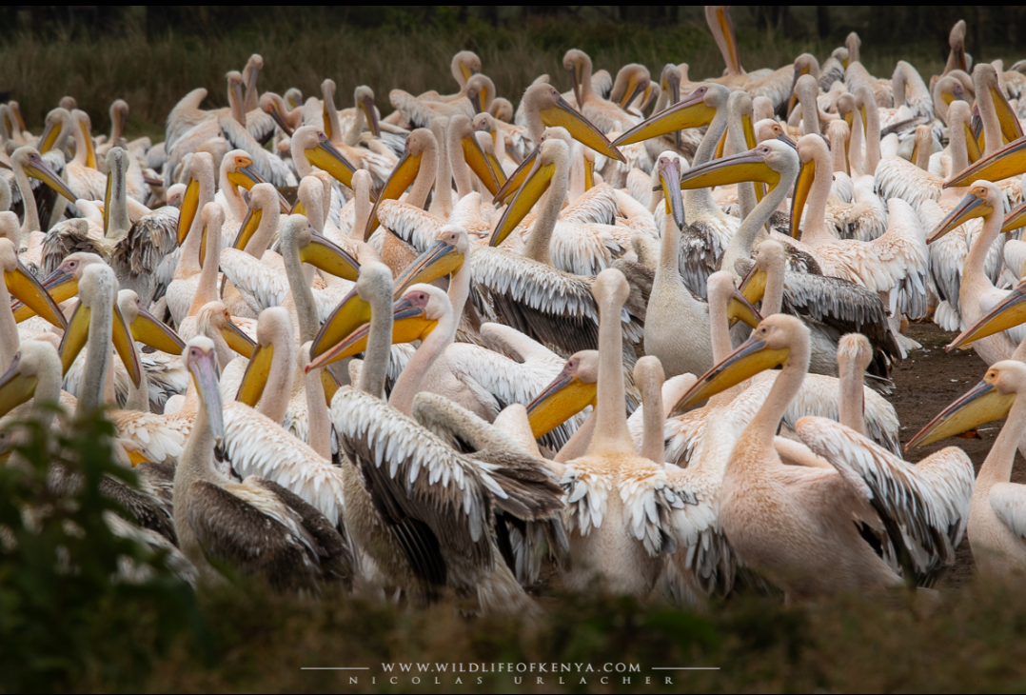
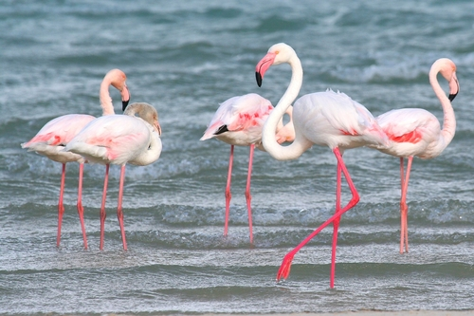
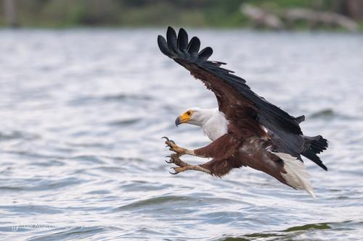
Vareschi, E. (1978). The ecology of Lake Nakuru
Secondary Consumers in the Aquatic Food Web
Great White Pelican
Greater flamingo
African Fish Eagle
Greater Flamingo
Pelecanus onocrotalus
Specialized piscivore driving energy transfer from fish populations to higher avian trophic levels.
Feeds predominantly on introduced Soda Tilapia (Alcolapia grahami) in open shallow waters.
Phoenicopterus roseus
Generalist filter feeder inhabiting alkaline lake shorelines and shallow waters.
Consumes a broader opportunistic diet including small invertebrates, aquatic insect larvae, and micro-algae.
Haliaeetus vocifer
Apex avian predator positioned at the top of the aquatic food chain interface.
Hunts surface-swimming fish and waterbirds from high acacia tree perches surrounding the lake shore.
Notes:
https://docs.google.com/document/d/16MW5gAP8jj4dnCR-bt6L1cZ3rx_Kois6d9RDyF61f1I/edit?usp=sharing

Slide 6
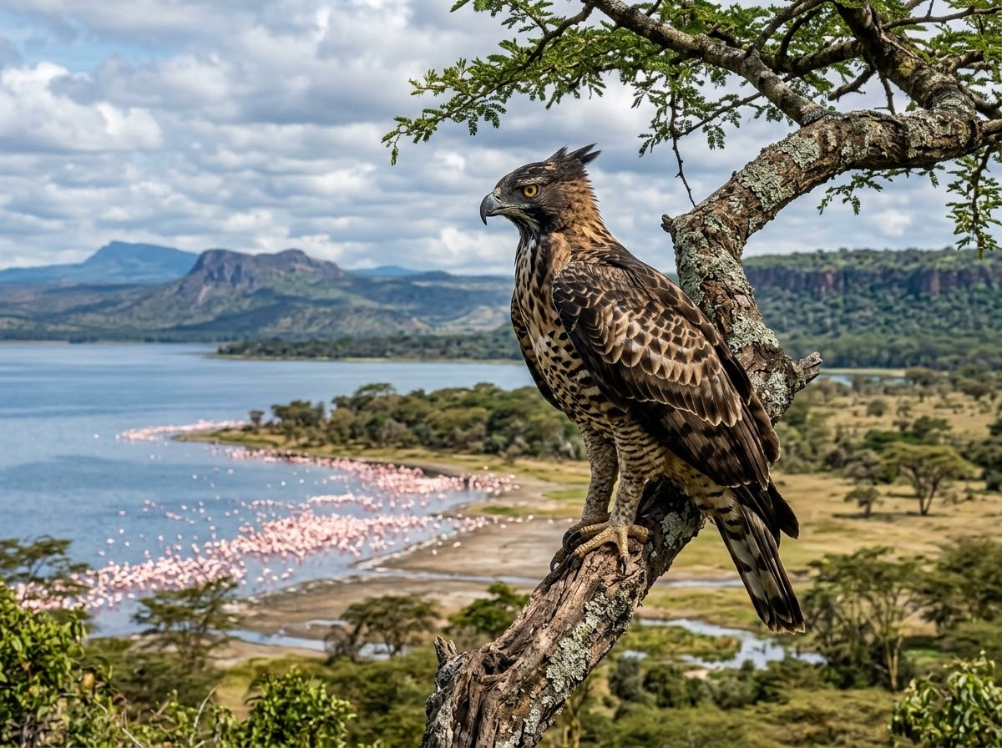
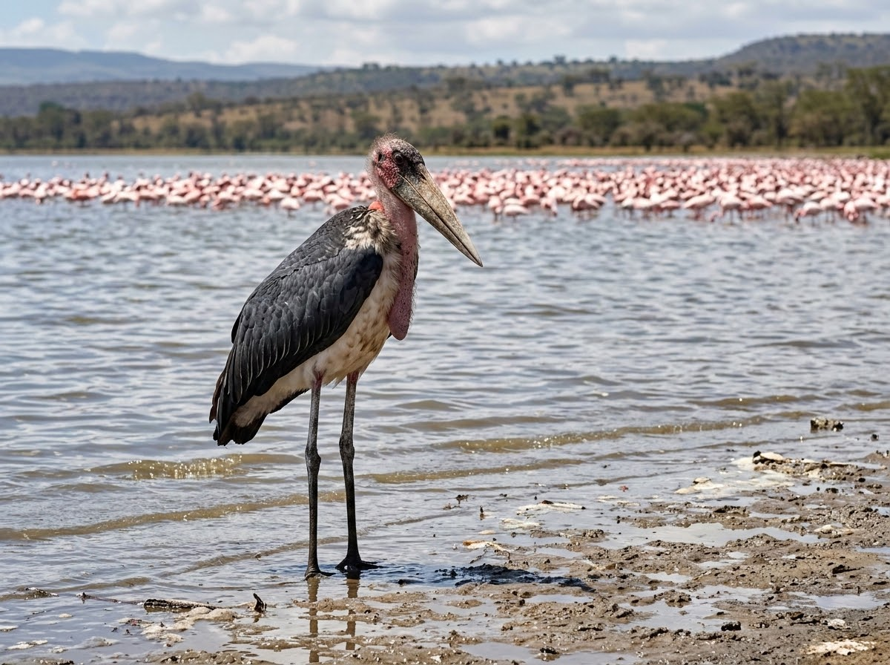
Vareschi, E. (1978). The ecology of Lake Nakuru
Tertiary Consumers in the Aquatic Food Web
BIRDS OF PREY (GREIFVÖGEL)
MARABOU STORKS (MARABUS)
Explicitly cited in literature as Konsumenten höherer Ordnung (higher-level consumers).
Apex avian predators that prey on fish-eating waterbirds and other terrestrial or aquatic vertebrates.
Leptoptilos crumenifer
Large opportunistic scavengers and carnivores occupying top trophic positions, feeding on fish, waterbird nestlings, and carrion.
"Regarding tertiary consumers, ecological literature is relatively vague and typically refers to them broadly as 'higher-level consumers.' Due to the short food chain in Lake Nakuru, top predators consist primarily of Birds of Prey and Marabou Storks preying on fish-eating birds or other vertebrates."
Notes:
https://docs.google.com/document/d/16MW5gAP8jj4dnCR-bt6L1cZ3rx_Kois6d9RDyF61f1I/edit?usp=sharing

Slide 7
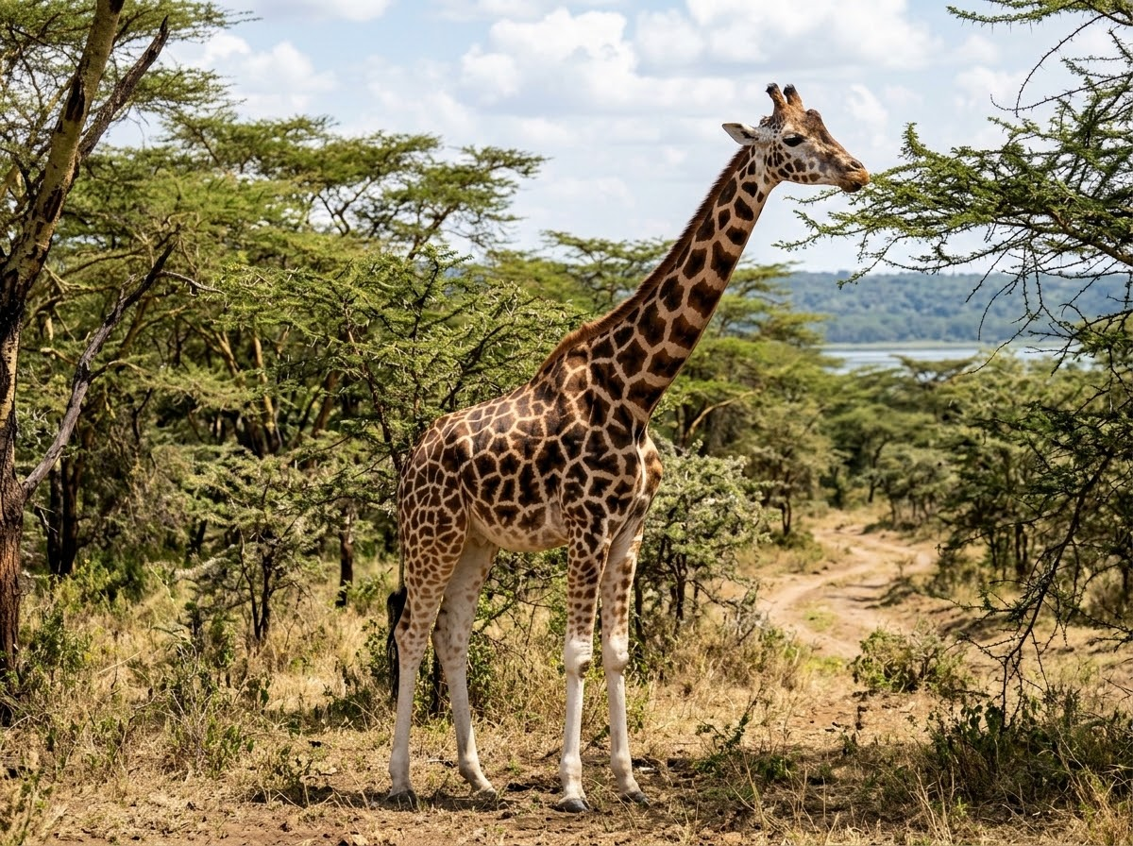
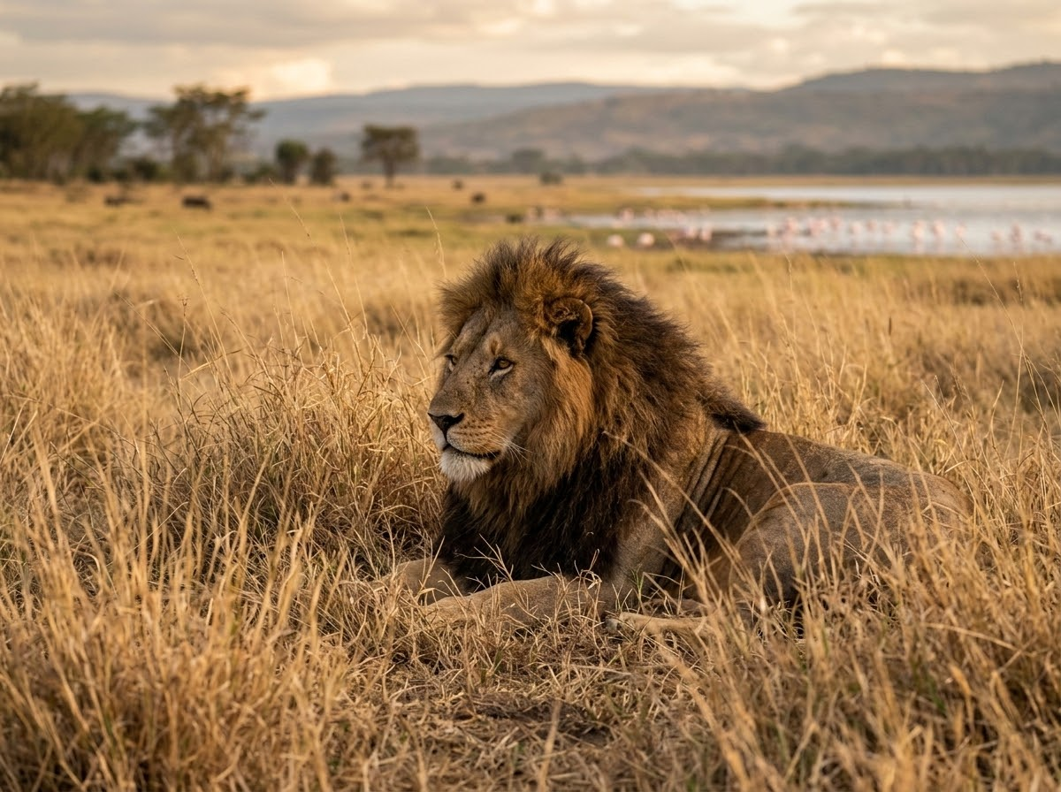
Vareschi, E. (1978). The ecology of Lake Nakuru
Terrestrial Trophic Dynamics & Lake Connections
PRIMARY CONSUMERS / HERBIVORES
PREDATORS
The Giraffe (Giraffa camelopardalis), Zebra (Equus quagga), African Buffalo (Syncerus caffer), and Black Rhinoceros (Diceros bicornis) feed on surrounding vegetation rather than lake production.
Apex predators such as the Lion (Panthera leo), Leopard (Panthera pardus), and African Rock Python (Python sebae) influence herbivore distribution.
"Terrestrial herbivores feed on vegetation, while predators feed on other animals. These terrestrial food webs are connected to the lake ecosystem through nutrient movement and animal activity."
Notes:
https://docs.google.com/document/d/16MW5gAP8jj4dnCR-bt6L1cZ3rx_Kois6d9RDyF61f1I/edit?usp=sharing

Slide 8
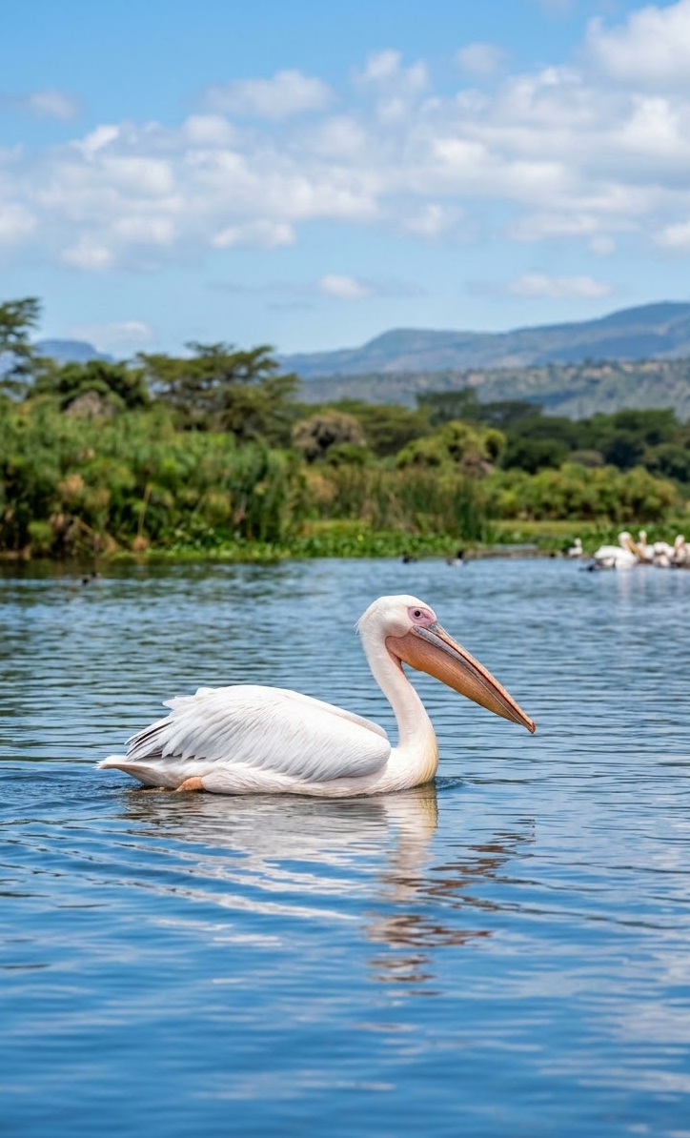
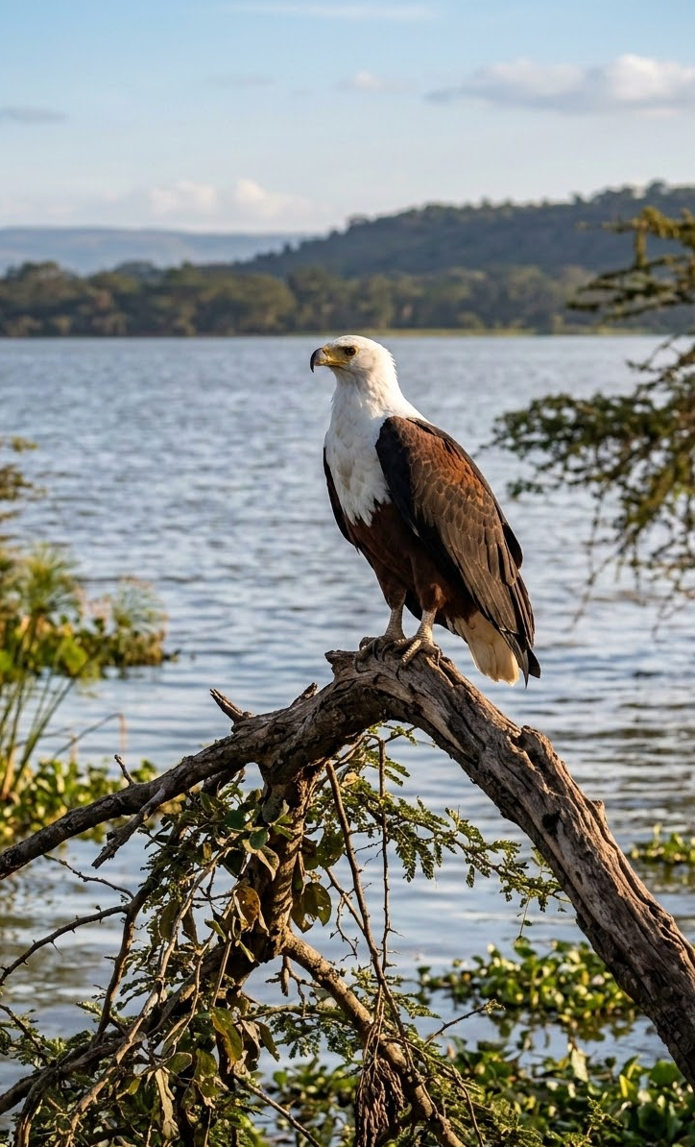
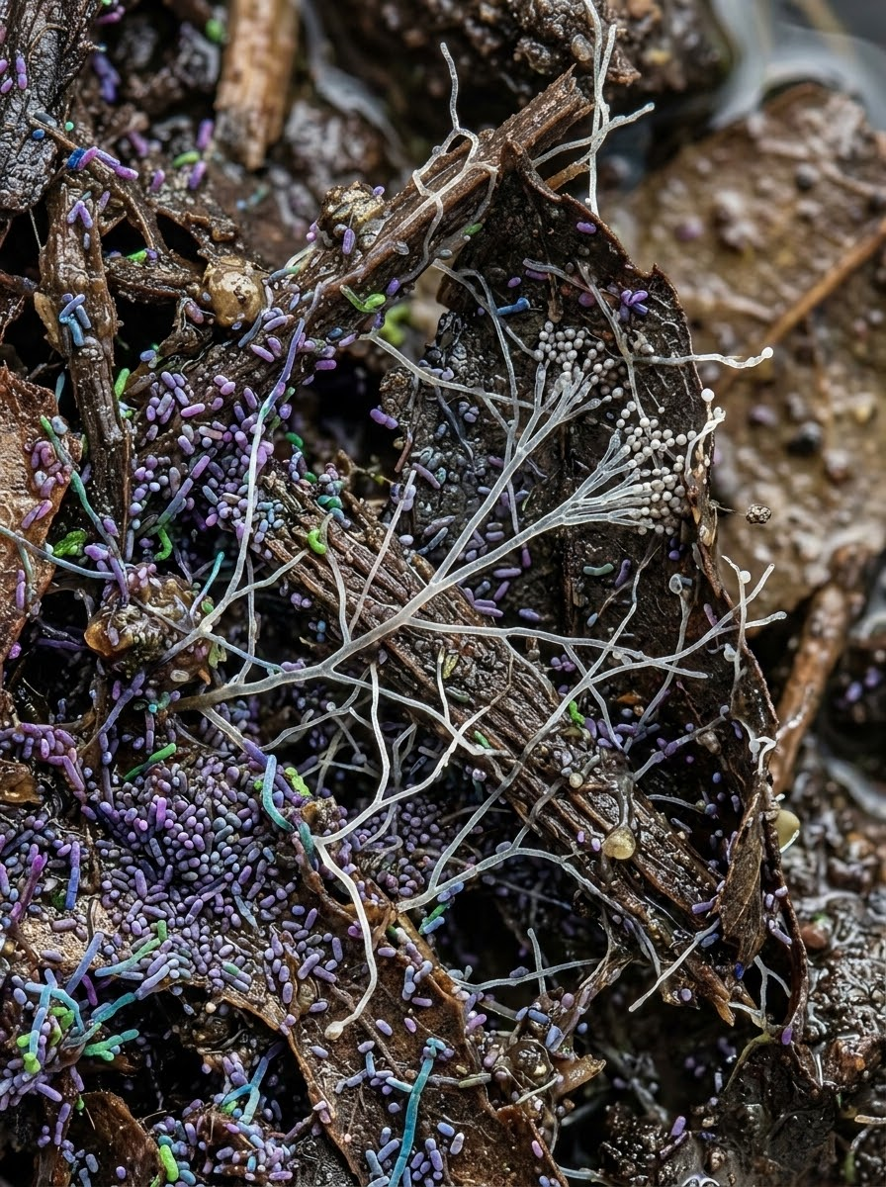
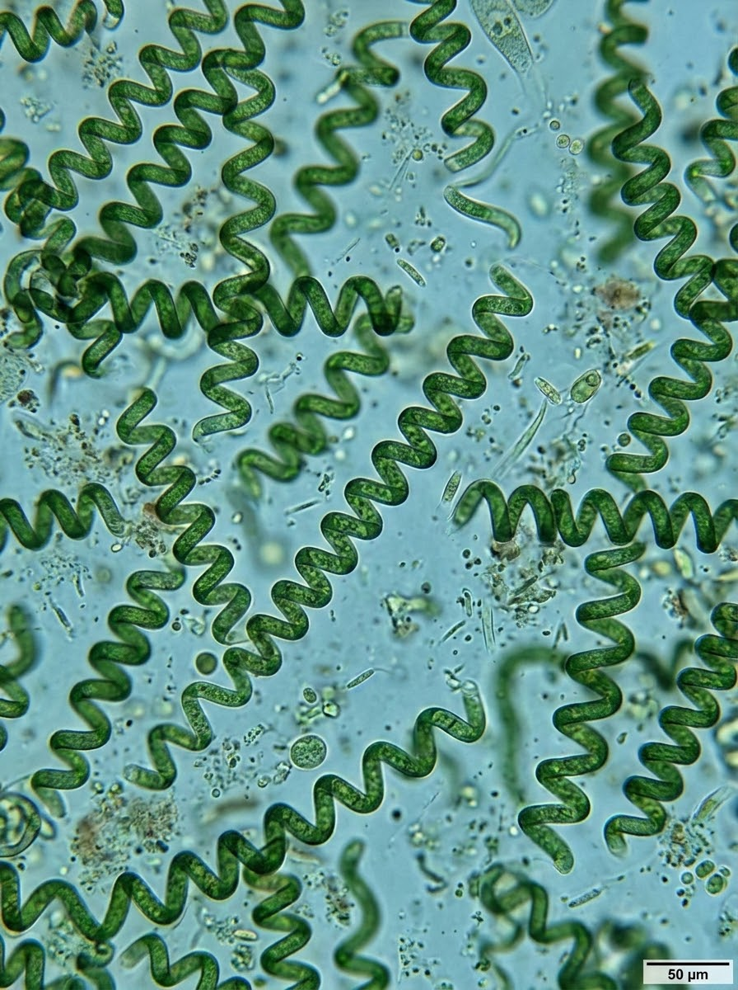
Vareschi, E. (1978). The ecology of Lake Nakuru
Trophic Structure & Aquatic Ecosystem Roles
Primary Consumers
Secondary Consumers
Tertiary Consumers
Lesser Flamingo (Phoeniconaias minor) & Soda Tilapia (Oreochromis grahami).
Feed directly on primary producers in alkaline aquatic environment.
Great White Pelican (Pelecanus onocrotalus) & Great Cormorant (Phalacrocorax carbo).
Act primarily as specialized piscivores within food web.
Trophic level dynamically depends on target prey availability.
Highlights feeding role flexibility and adaptive predation strategies across ecosystem structure.
Decomposers
Producers
Microscopic bacteria & fungi.
Essential for recycling organic nutrients back into the ecosystem from dead organic matter.
Microscopic algae & cyanobacteria, primarily Spirulina platensis (formerly Arthrospira).
Thrive abundantly in highly alkaline waters.
Notes:
https://docs.google.com/document/d/16MW5gAP8jj4dnCR-bt6L1cZ3rx_Kois6d9RDyF61f1I/edit?usp=sharing

Slide 9

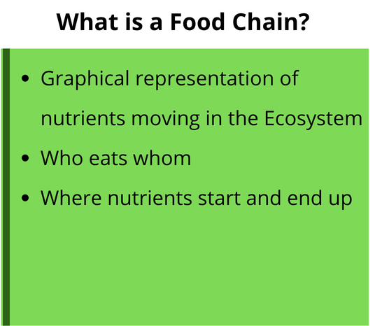
Notes:
https://docs.google.com/document/d/16MW5gAP8jj4dnCR-bt6L1cZ3rx_Kois6d9RDyF61f1I/edit?usp=sharing

Slide 10
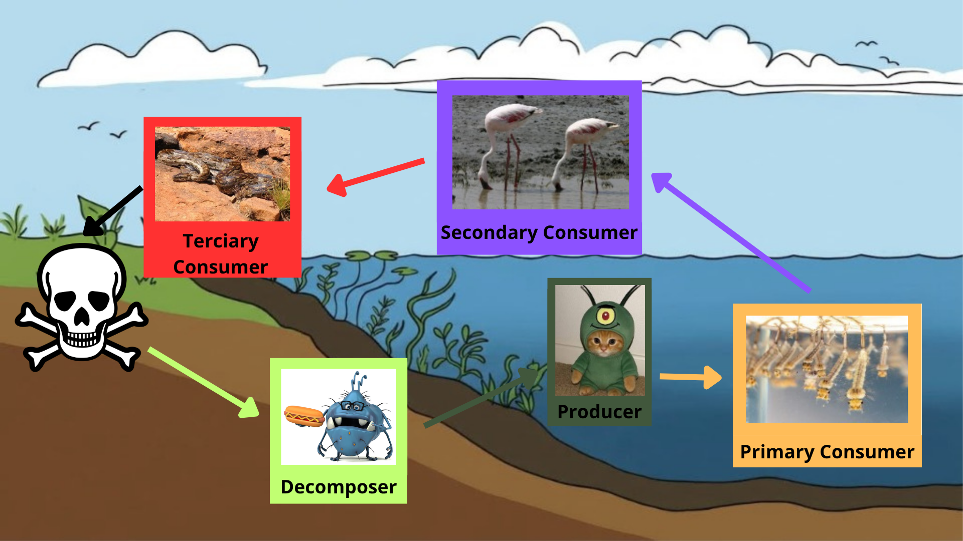
Notes:
https://docs.google.com/document/d/16MW5gAP8jj4dnCR-bt6L1cZ3rx_Kois6d9RDyF61f1I/edit?usp=sharing

Slide 11
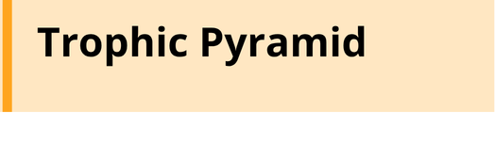
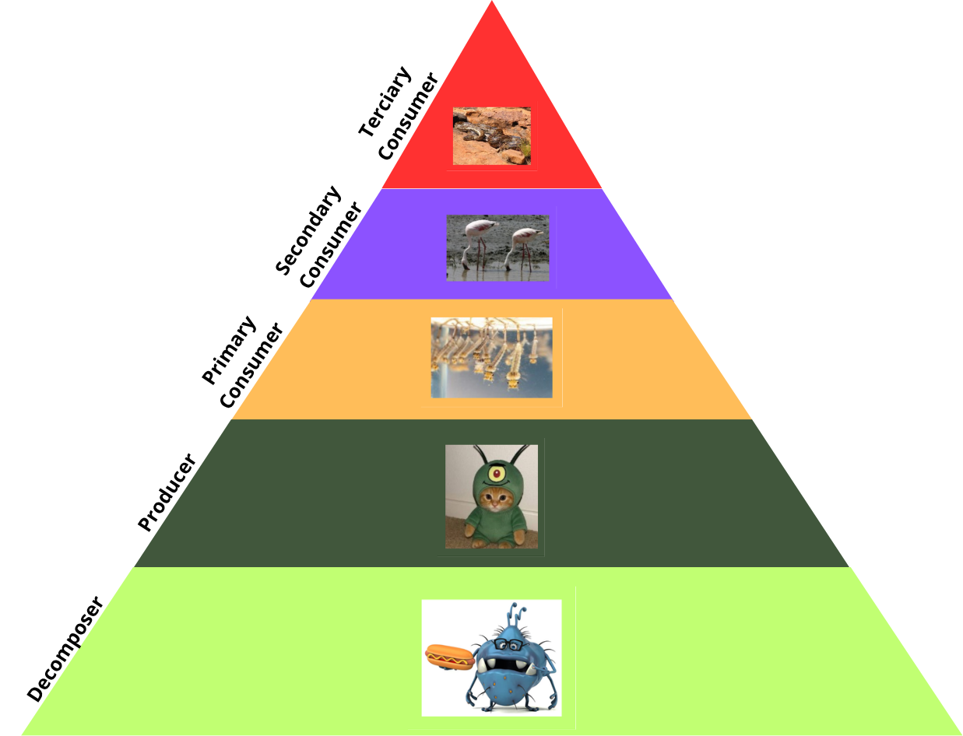
Britannica Editors (2026, September 2).
Notes:
https://docs.google.com/document/d/16MW5gAP8jj4dnCR-bt6L1cZ3rx_Kois6d9RDyF61f1I/edit?usp=sharing

Slide 12
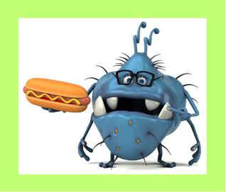
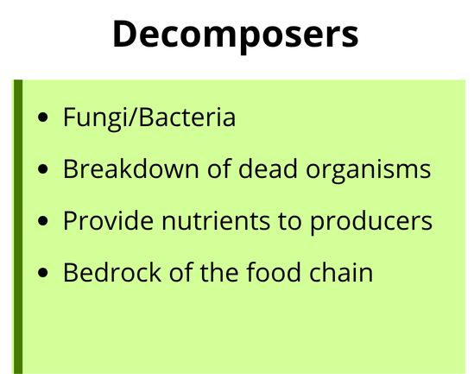
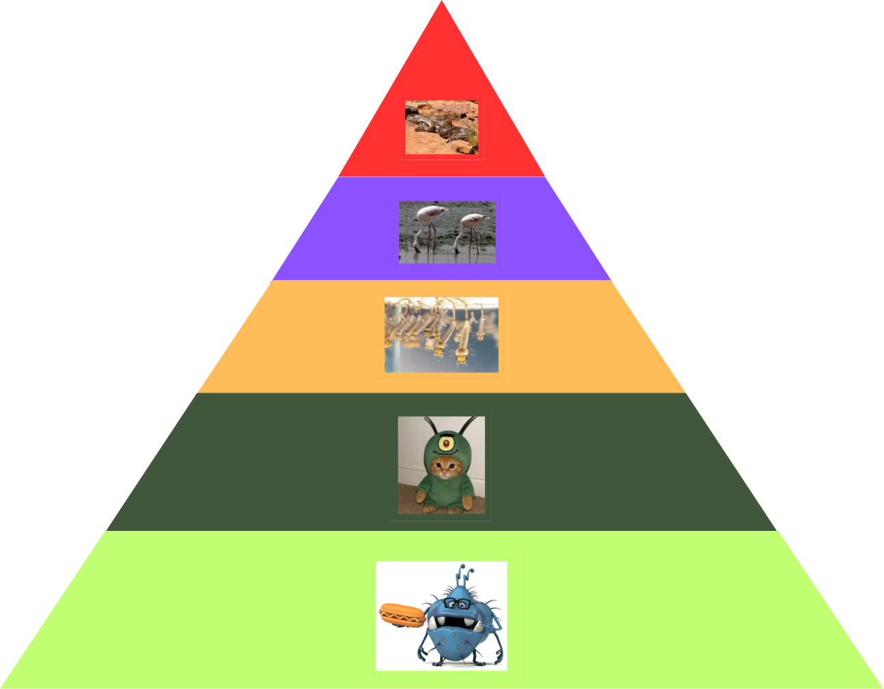

Sottosanti, K. (2026, October 10).
Notes:
https://docs.google.com/document/d/16MW5gAP8jj4dnCR-bt6L1cZ3rx_Kois6d9RDyF61f1I/edit?usp=sharing

Slide 13

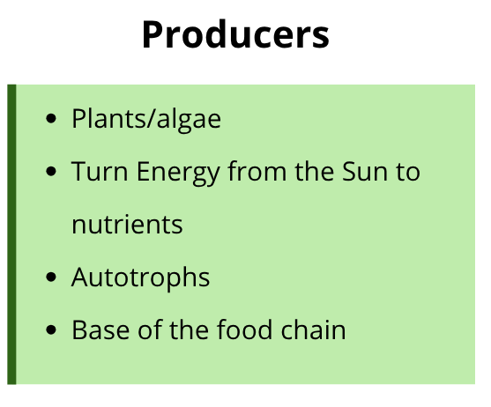
Sottosanti, K. (2026, October 10).
Notes:
https://docs.google.com/document/d/16MW5gAP8jj4dnCR-bt6L1cZ3rx_Kois6d9RDyF61f1I/edit?usp=sharing

Slide 14
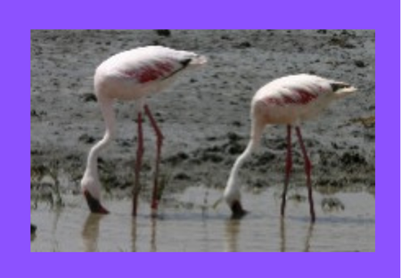
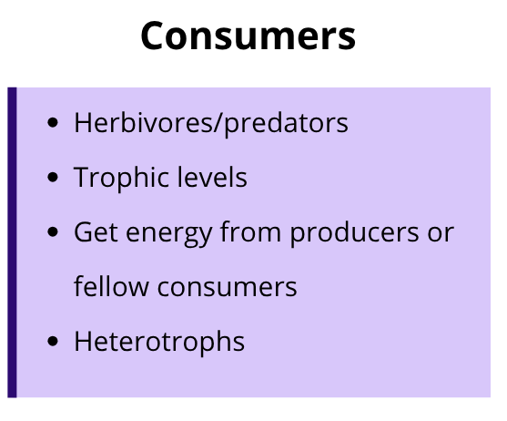
Sottosanti, K. (2026, October 10).
Notes:
https://docs.google.com/document/d/16MW5gAP8jj4dnCR-bt6L1cZ3rx_Kois6d9RDyF61f1I/edit?usp=sharing

Slide 15
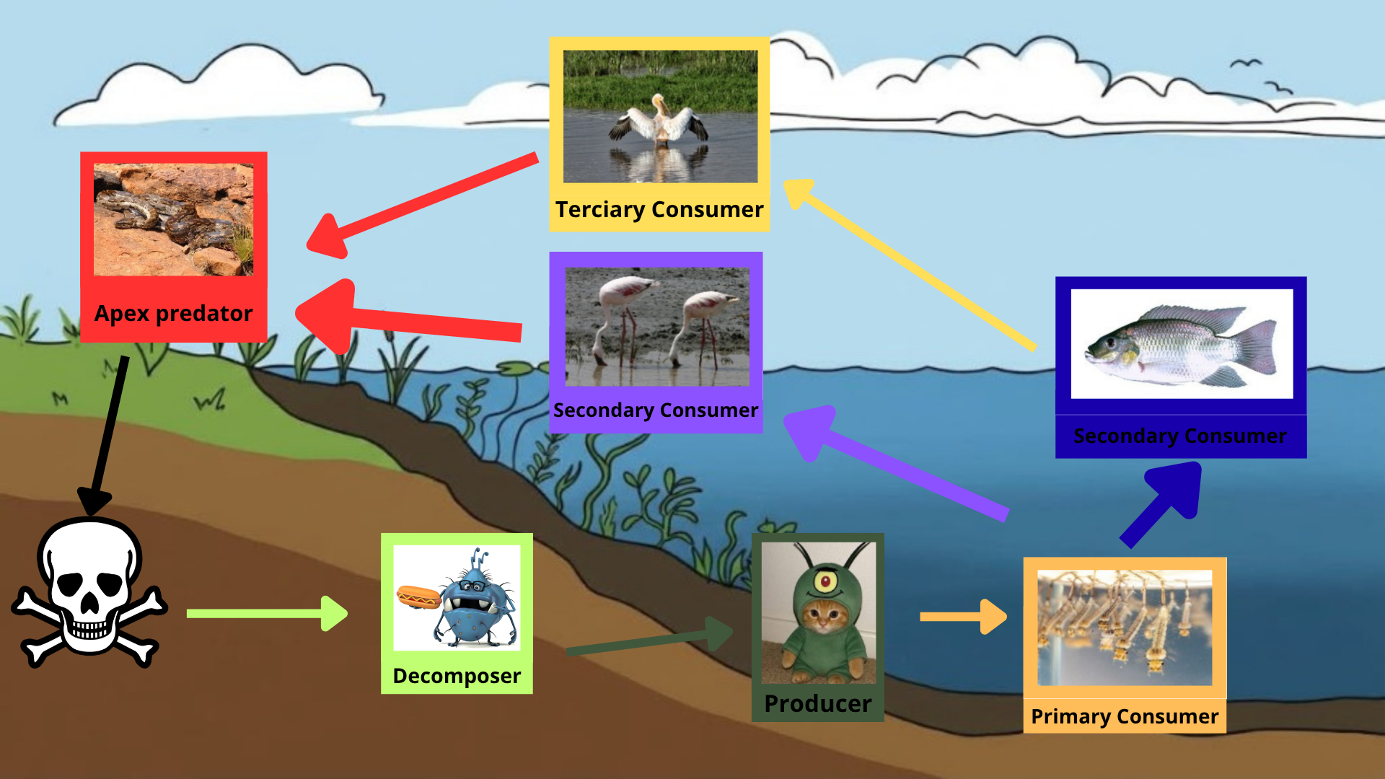
Notes:
https://docs.google.com/document/d/16MW5gAP8jj4dnCR-bt6L1cZ3rx_Kois6d9RDyF61f1I/edit?usp=sharing

Slide 16

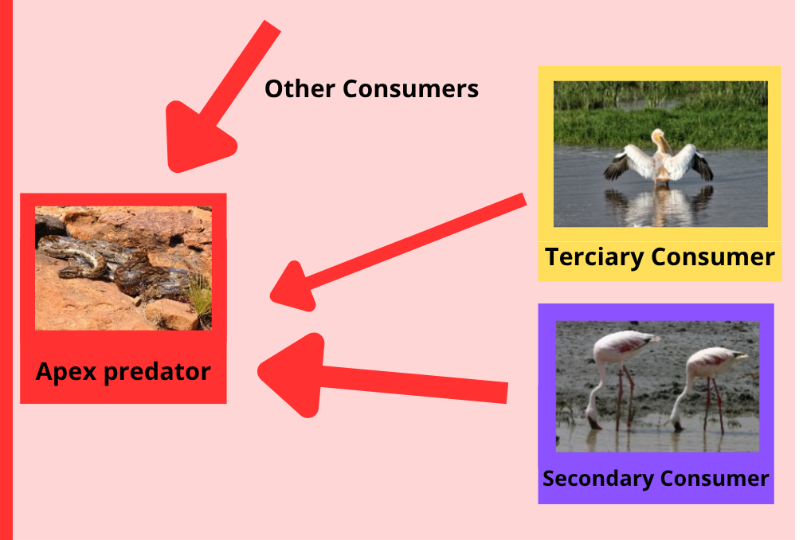
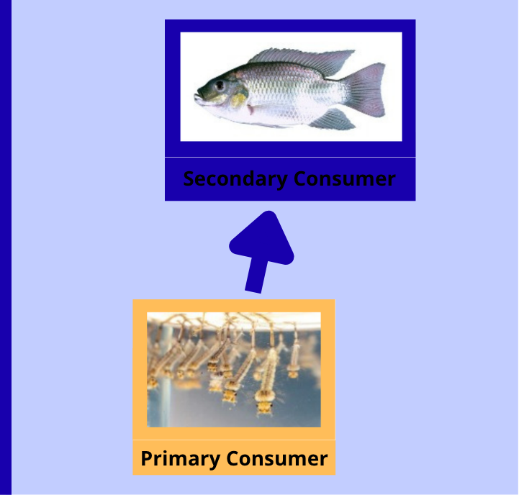
Weak
Strong
Notes:
https://docs.google.com/document/d/16MW5gAP8jj4dnCR-bt6L1cZ3rx_Kois6d9RDyF61f1I/edit?usp=sharing

Slide 17
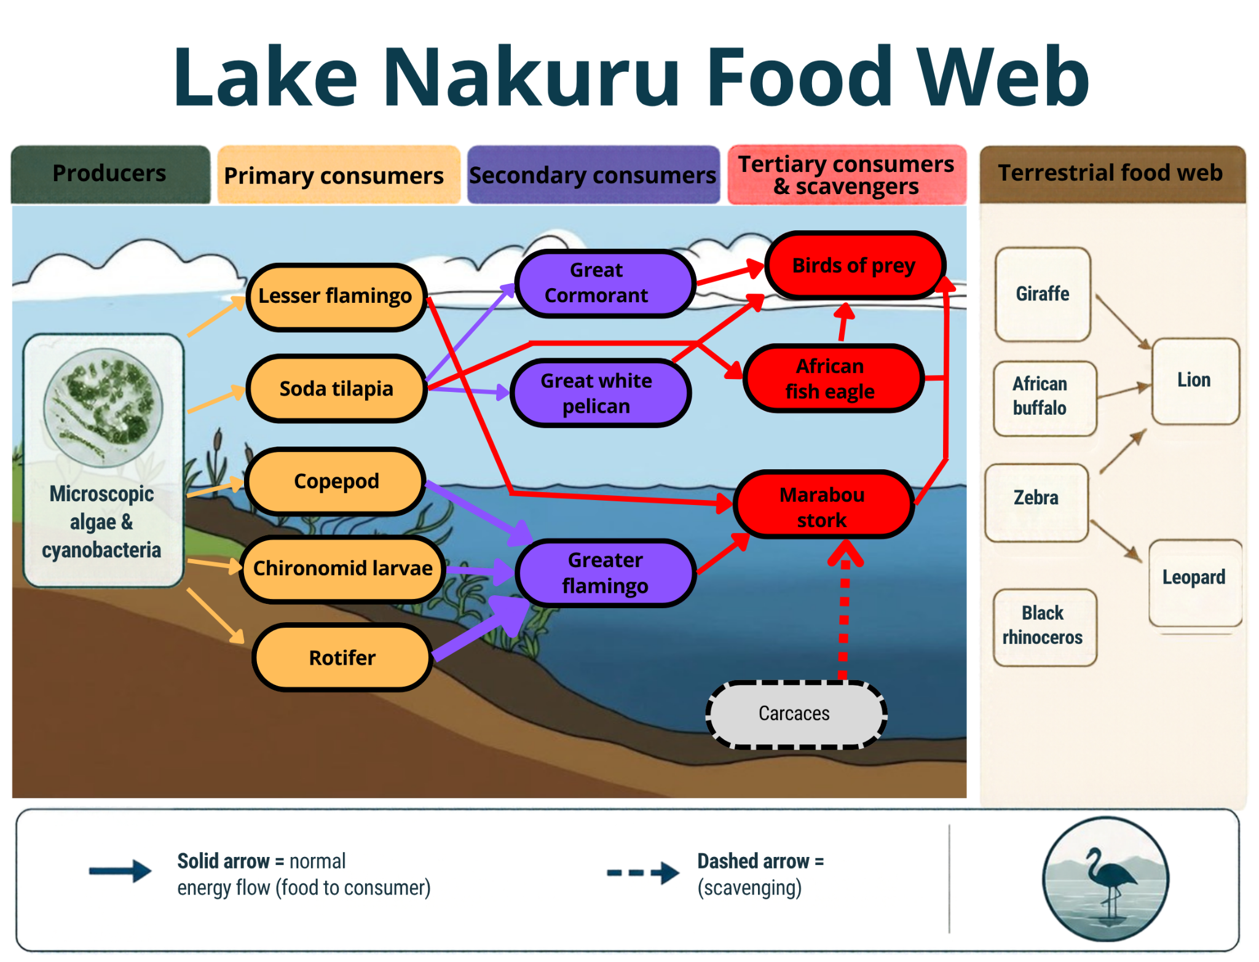
Notes:
https://docs.google.com/document/d/16MW5gAP8jj4dnCR-bt6L1cZ3rx_Kois6d9RDyF61f1I/edit?usp=sharing

Slide 18
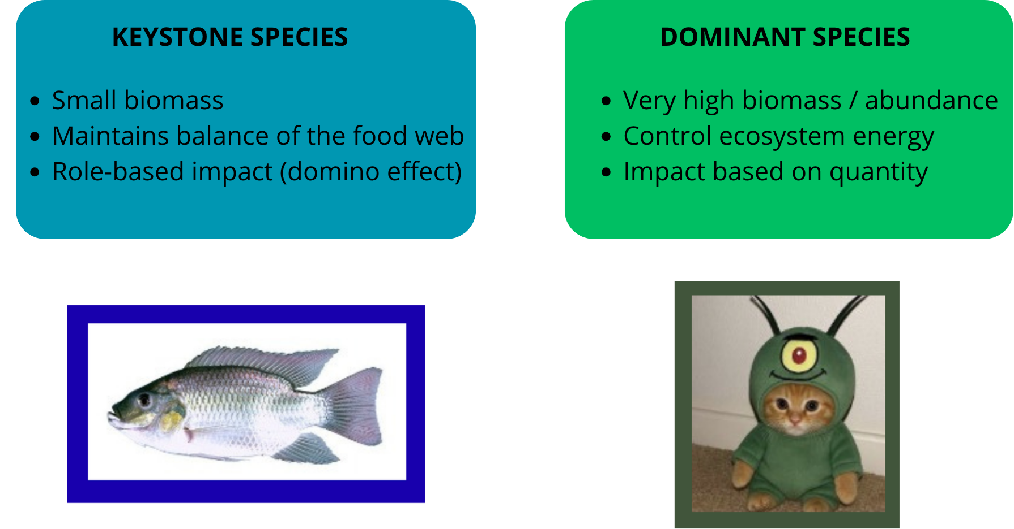
Thompson, J.N. (2023, October 9).
Smee, D. (2010)
Notes:
https://docs.google.com/document/d/16MW5gAP8jj4dnCR-bt6L1cZ3rx_Kois6d9RDyF61f1I/edit?usp=sharing

Slide 19
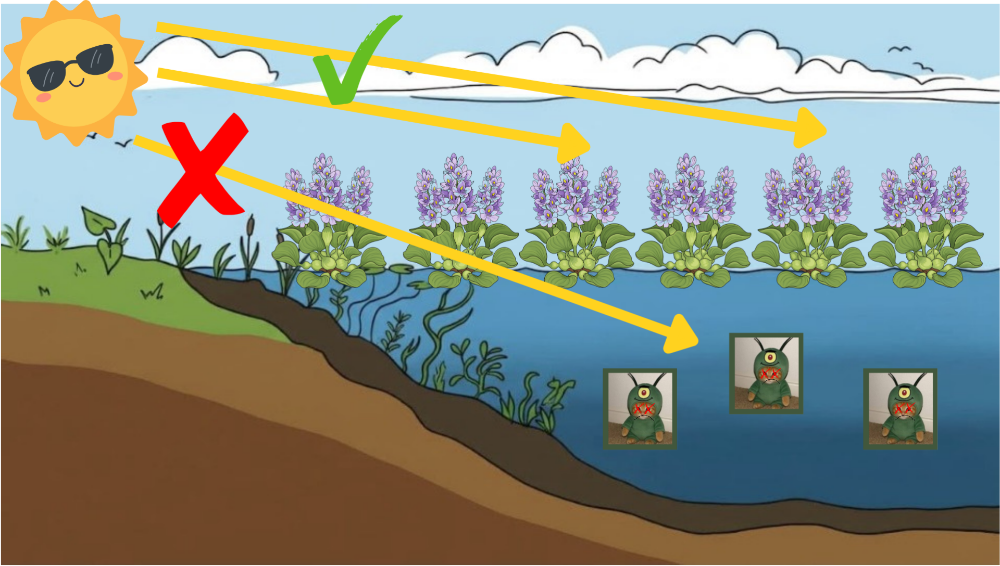
Notes:
https://docs.google.com/document/d/16MW5gAP8jj4dnCR-bt6L1cZ3rx_Kois6d9RDyF61f1I/edit?usp=sharing

Slide 20
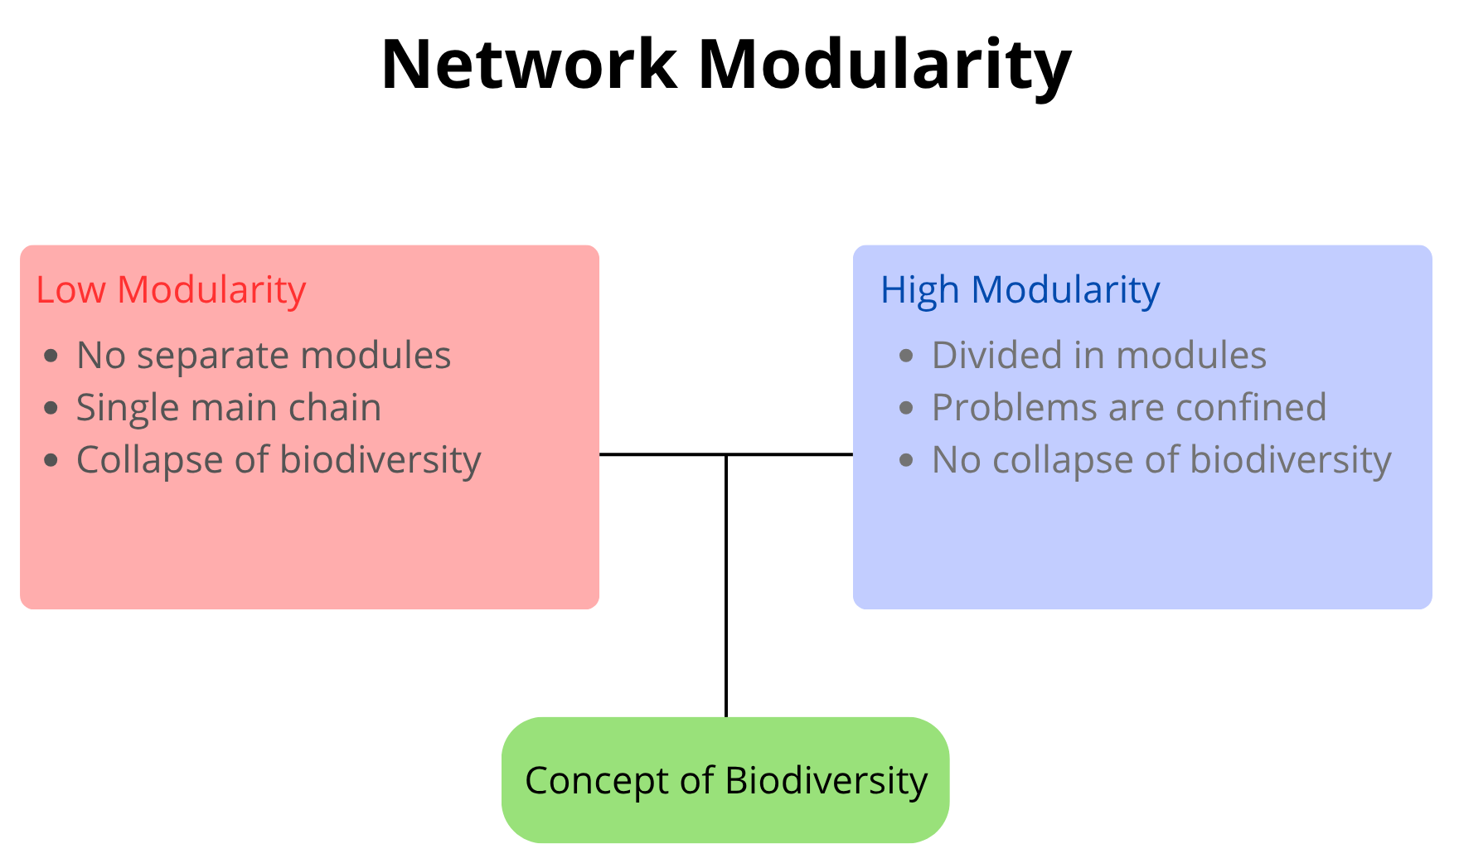
Notes:
https://docs.google.com/document/d/16MW5gAP8jj4dnCR-bt6L1cZ3rx_Kois6d9RDyF61f1I/edit?usp=sharing

Slide 21
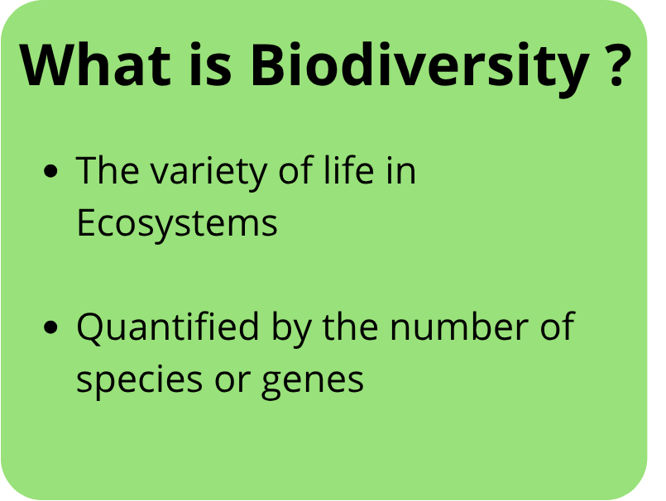
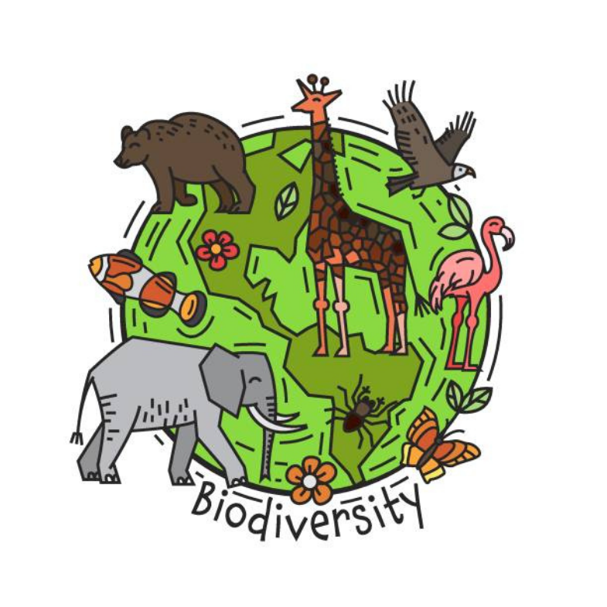
K.R.S. et al. (2026)
Notes:
https://docs.google.com/document/d/16MW5gAP8jj4dnCR-bt6L1cZ3rx_Kois6d9RDyF61f1I/edit?usp=sharing

Slide 22

Paine, R. T. (1966)
NETWORK RESILIENCE
K.R.S. et al. (2026)
Food Web Complexity & Biodiversity
Multiple Feeding Links
Diverse species relationships allow greater ecological coexistence.
Alternative Prey Routes
Diet switching maintains energy flow during single-source declines.
Ecological Niche Variety
Varied resource usage buffers ecosystems against direct competition.
Complexity supports resilience, though highly complex webs are not automatically stable.
Notes:
https://docs.google.com/document/d/16MW5gAP8jj4dnCR-bt6L1cZ3rx_Kois6d9RDyF61f1I/edit?usp=sharing

Slide 23

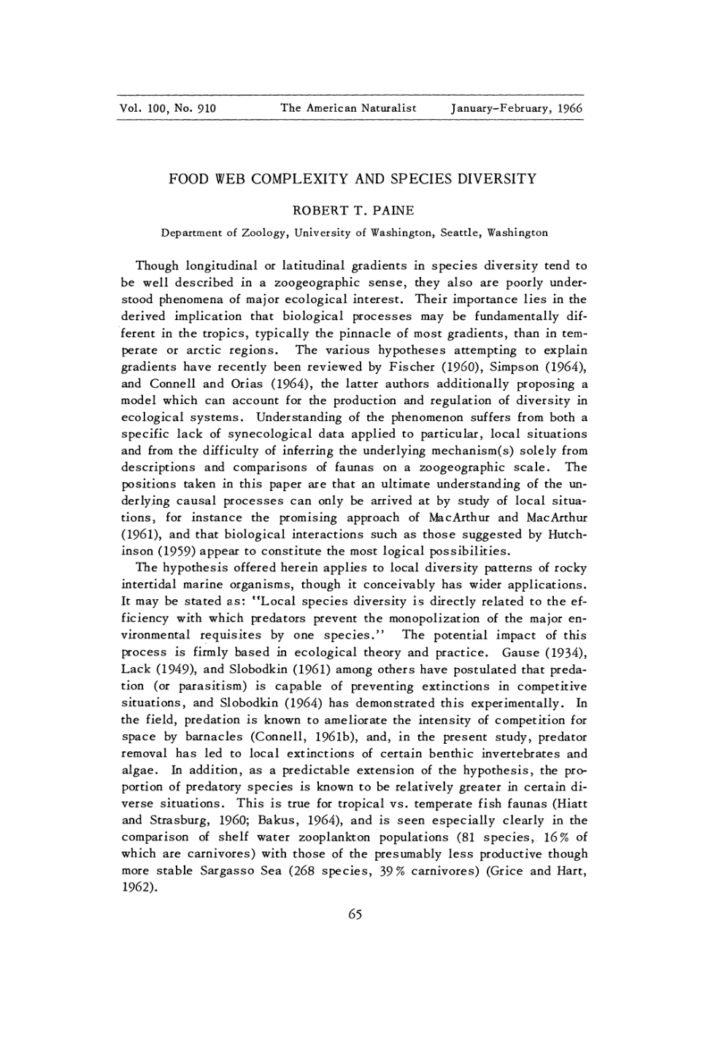



How Does Food Web Complexity Affect Biodiversity ?
Notes:
https://docs.google.com/document/d/16MW5gAP8jj4dnCR-bt6L1cZ3rx_Kois6d9RDyF61f1I/edit?usp=sharing

Slide 24
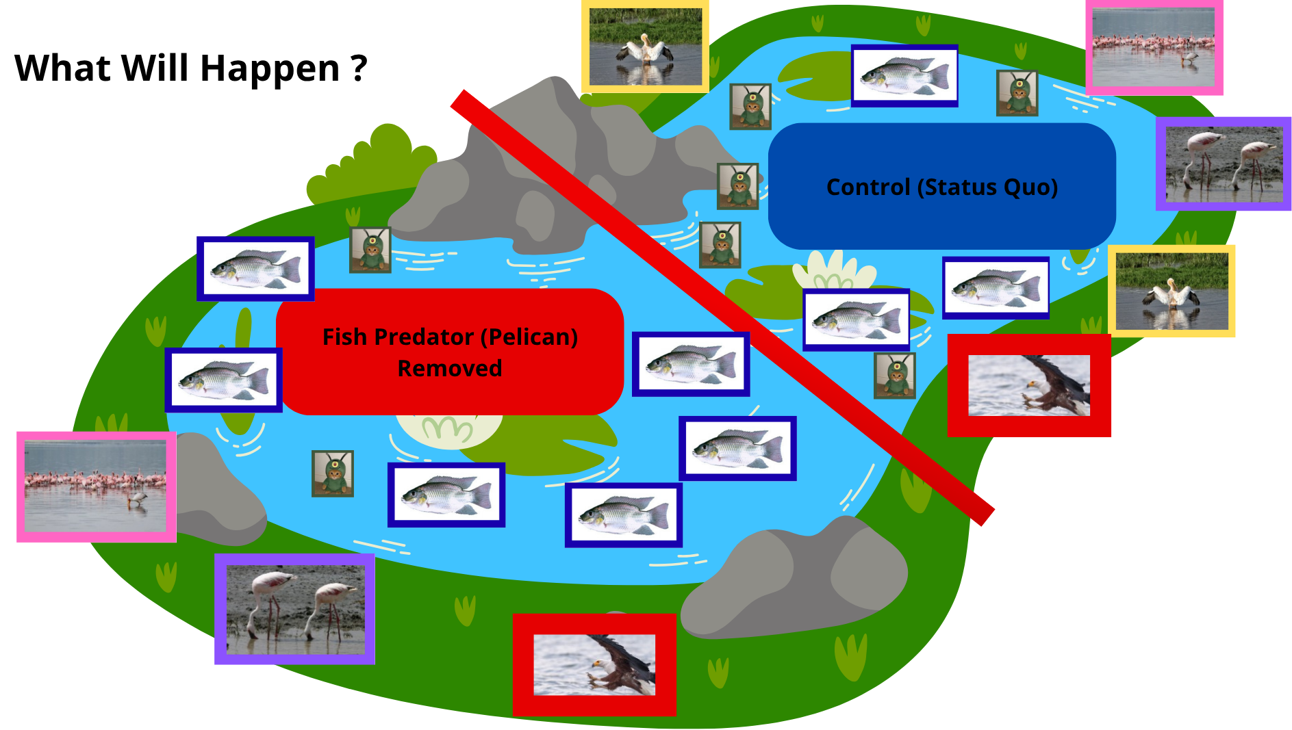
Paine, R. T. (1966)
Notes:
https://docs.google.com/document/d/16MW5gAP8jj4dnCR-bt6L1cZ3rx_Kois6d9RDyF61f1I/edit?usp=sharing

Slide 25
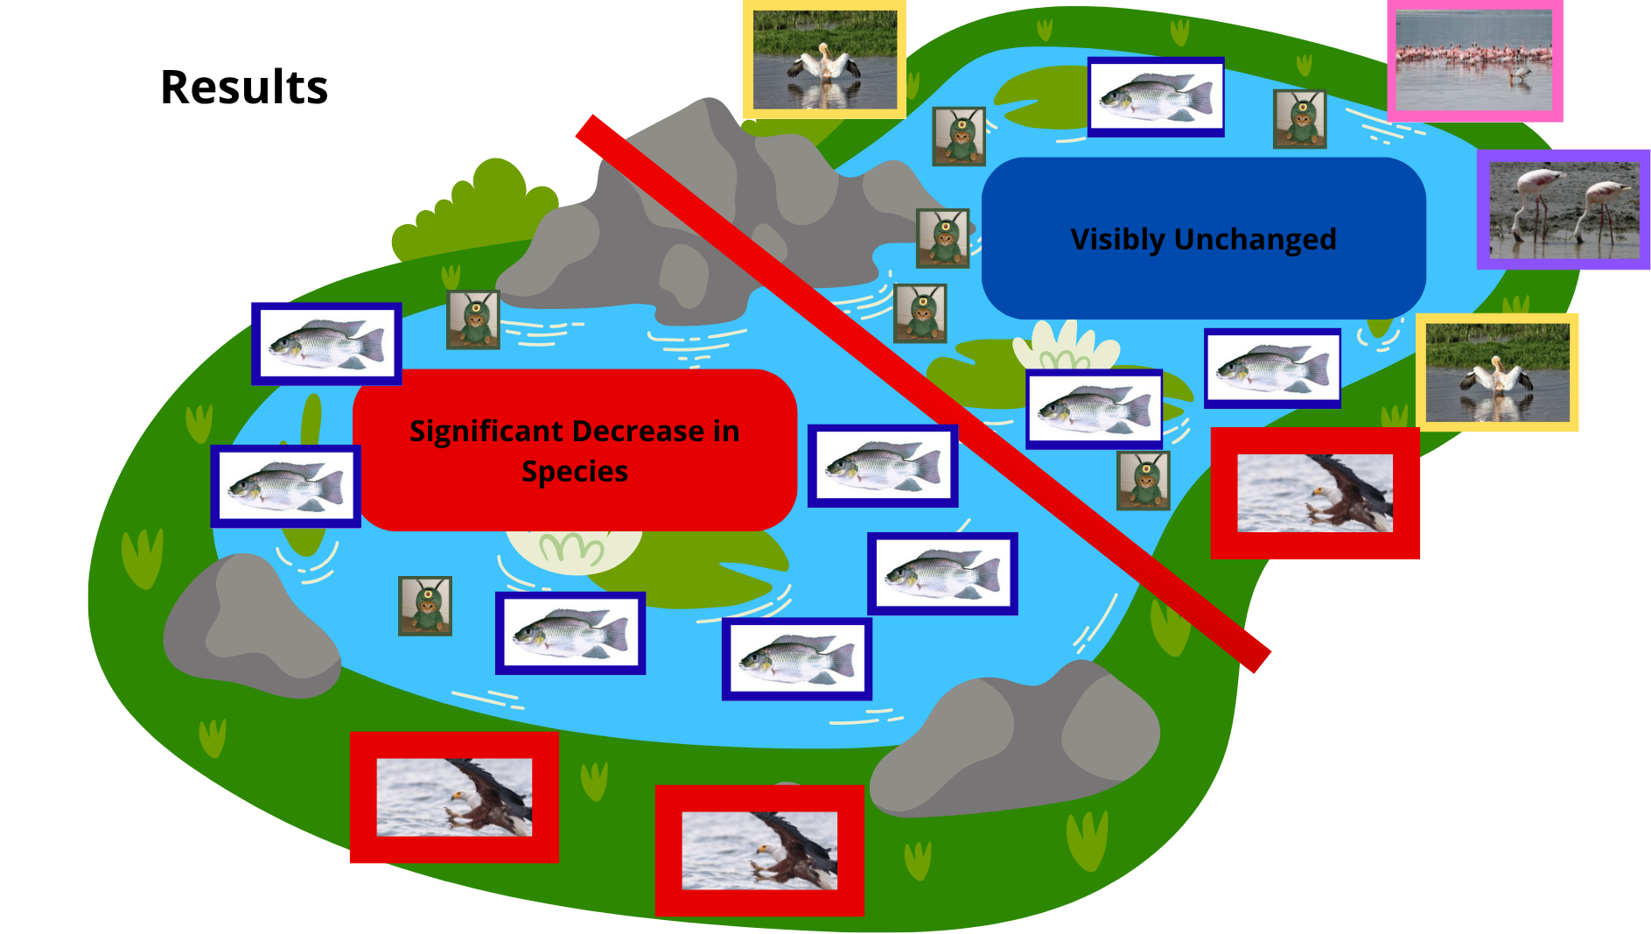
Paine, R. T. (1966)
Notes:
https://docs.google.com/document/d/16MW5gAP8jj4dnCR-bt6L1cZ3rx_Kois6d9RDyF61f1I/edit?usp=sharing

Slide 26
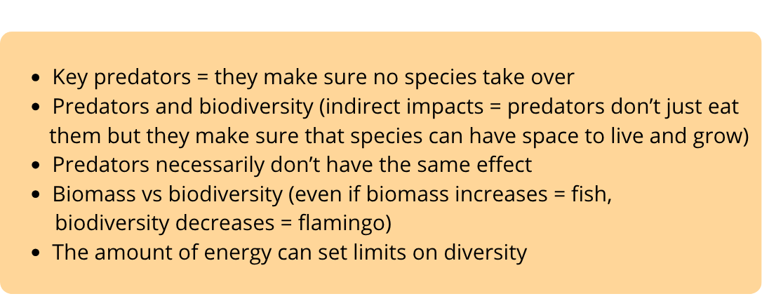
Summary of what happened
Paine, R. T. (1966)
Notes:
https://docs.google.com/document/d/16MW5gAP8jj4dnCR-bt6L1cZ3rx_Kois6d9RDyF61f1I/edit?usp=sharing

Slide 27
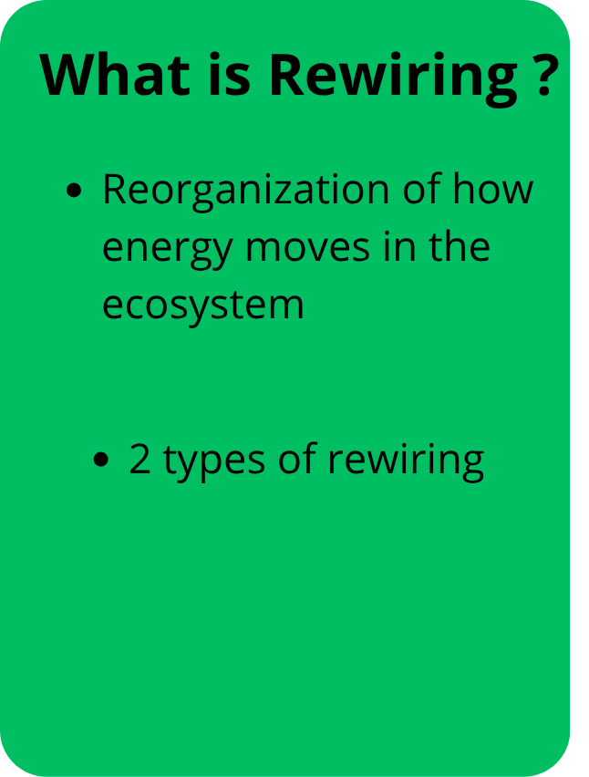
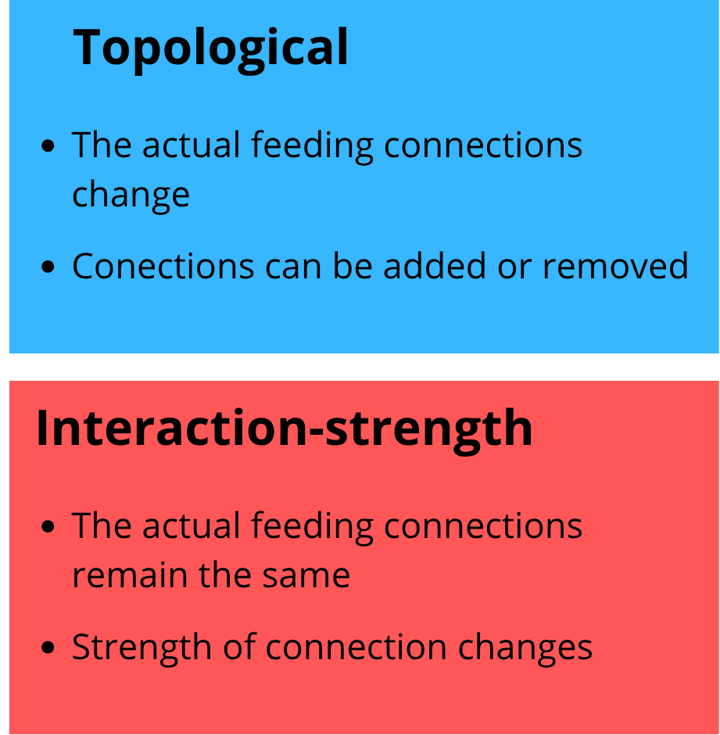
Bartley-et-al.-2019
Notes:
https://docs.google.com/document/d/16MW5gAP8jj4dnCR-bt6L1cZ3rx_Kois6d9RDyF61f1I/edit?usp=sharing

Slide 28
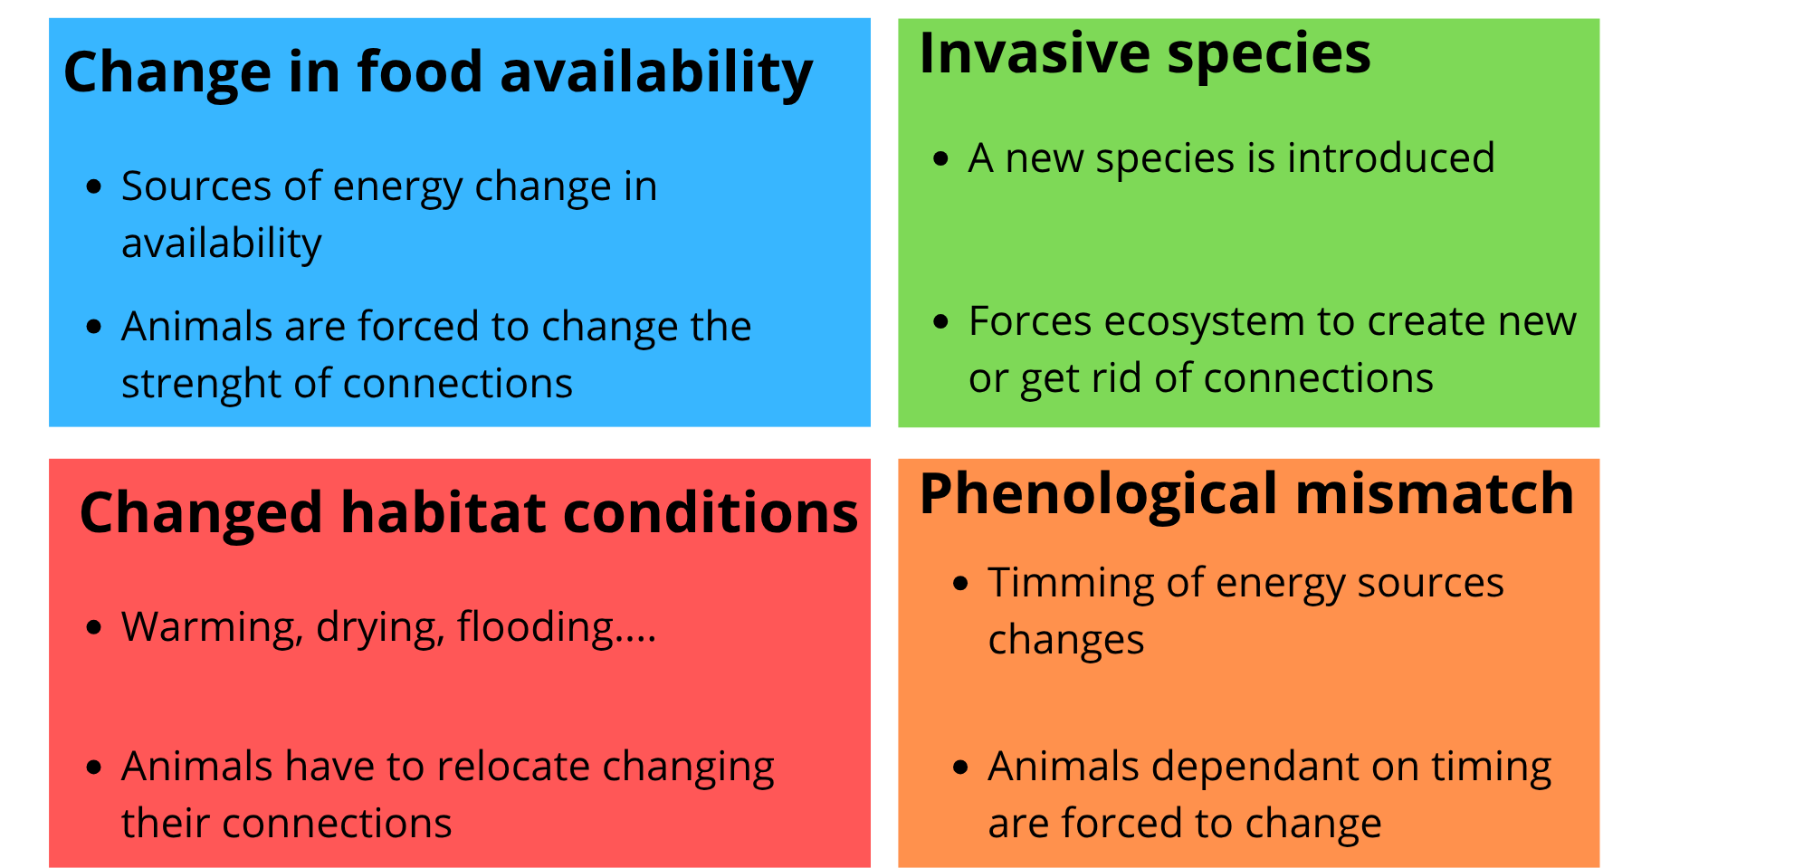
What can cause rewiring ?
Bartley-et-al.-2019
Notes:
https://docs.google.com/document/d/16MW5gAP8jj4dnCR-bt6L1cZ3rx_Kois6d9RDyF61f1I/edit?usp=sharing

Slide 29

ECOSYSTEM DISRUPTION
How Invasive Species Rewire Food Webs
Resource Competition
Direct Predation
Indirect Effects
Network Disruption
Native species lose food access as invaders establish rapid dominion.
Vulnerable local populations undergo steep declines due to new pressure.
Cascade changes affect organisms far removed from direct interaction.
Interconnected web links destabilize across multiple trophic levels.
Notes:
https://docs.google.com/document/d/16MW5gAP8jj4dnCR-bt6L1cZ3rx_Kois6d9RDyF61f1I/edit?usp=sharing

Slide 30
The Team
Francesca Goretti
Yoan Gonon
Denis Drahokoupil
Ukasha Katende
Eugenia Olari
-Food web
-Dominant and keystone species
- Network modularity
- Introduction of the ecosystem
Food Chains
Biodiversity Example
Rewiring
Introduction of the ecosystem
Notes:
https://docs.google.com/document/d/16MW5gAP8jj4dnCR-bt6L1cZ3rx_Kois6d9RDyF61f1I/edit?usp=sharing

Slide 31
Questions ?
Notes:
https://docs.google.com/document/d/16MW5gAP8jj4dnCR-bt6L1cZ3rx_Kois6d9RDyF61f1I/edit?usp=sharing

Slide 32
Sources Library
Vareschi, E. (1978). The ecology of Lake Nakuru (Kenya). I. Abundance and feeding of the lesser flamingo. Oecologia, 32(1), 11–35. https://doi.org/10.1007/BF00344687
Vareschi, E., & Vareschi, A. (1984). The ecology of Lake Nakuru (Kenya). IV. Biomass and distribution of consumer organisms. Oecologia, 61(1), 70–82. https://doi.org/10.1007/BF00379091
Vareschi, E., & Jacobs, J. (1984). The ecology of Lake Nakuru (Kenya). V. Production and consumption of consumer organisms. Oecologia, 61(1), 83–98. https://doi.org/10.1007/BF00379092
Vareschi, E., & Jacobs, J. (1985). The ecology of Lake Nakuru. VI. Synopsis of production and energy flow. Oecologia, 65(3), 412–424. https://doi.org/10.1007/BF00378917
Kaggwa, M. N., Gruber, M., Oduor, S. O., & Schagerl, M. (2013). A detailed time series assessment of the diet of lesser flamingos: Further explanation for their itinerant behaviour. Hydrobiologia, 710, 83–93. https://doi.org/10.1007/s10750-012-1105-1
Charlotte A. Ward, Tyler D. Tunney, Kayla R. S. Hale, Reilly F. O’Connor & Kevin S. McCann: The rewiring of ecological networks in a variable world https://www.nature.com/articles/s44358-026-00159-9
Kerlley Bong Siew Sin: Dissappearing pink flamingos and evolution of lake nakuru https://sunwayuniversity.edu.my/explore/thinkpieces/disappearing-pink-flamingos-and-evolution-of-lake-nakuru
Paine, R. T. (1966). Food Web Complexity and Species Diversity. The American Naturalist, 100(910), 65–75. http://www.jstor.org/stable/2459379
Sottosanti, K. (2026, October 10). food web. Encyclopedia Britannica. https://www.britannica.com/science/food-web
Britannica Editors (2026, September 2). trophic pyramid. Encyclopedia Britannica. https://www.britannica.com/science/trophic-pyramid
Thompson, J.N. (2023, October 9). keystone species. Encyclopedia Britannica. https://www.britannica.com/science/keystone-species
Smee, D. (2010) Species with a Large Impact on Community Structure. Nature Education Knowledge 3(10):40
Bartley, T.J., McCann, K.S., Bieg, C. et al. Food web rewiring in a changing world. Nat Ecol Evol 3, 345–354 (2019). https://doi.org/10.1038/s41559-018-0772-3
Images:
https://www.wildlifeofkenya.com/categories/wading-and-water-birds/pelican-great-white/
https://www.inaturalist.org/places/lake-nakuru?__cf_chl_tk=FfSHRLRIm3DfN8k4XOtYz6XR3TszGcgTWHVAtYWaP2Y-1792263216-1.0.1.1-O1kZih3NaFUEDbeUODiqY5NdKjhOn7XF8PNEAIGfNIw#page=1&taxon=3
https://sunwayuniversity.edu.my/explore/thinkpieces/disappearing-pink-flamingos-and-evolution-of-lake-nakuru
Notes:
https://docs.google.com/document/d/16MW5gAP8jj4dnCR-bt6L1cZ3rx_Kois6d9RDyF61f1I/edit?usp=sharing

